Slide 1

PCE Pop Up
Empowering Ethical Prosecution
How to Enhance Your Office Culture
December 8, 2021
Timothy J. Koller
Chief Assistant District Attorney
Office of the Richmond County District Attorney
(718) 556-7090
timothy.koller@rcda.nyc.gov

Slide 2
How Can We Empower
Ethical Prosecutions?
How Can We Enhance
Our Office Ethics Culture?
AN OVERVIEW

Slide 3
                A Good Start…..
                An Ethics Statement from
                the District Attorney
(in your materials)
                Identifies the Office’s Ethical Culture
                This message must come from the top

Slide 4
New York State
District Attorneys Association
(“DAASNY”)
The Right Thing 2021
(in your materials)

Slide 5
                DAASNY’s
                Ethics Guidance Group

Slide 6
                Training

Slide 7
    Ethics Training is essential
    Execution of the principles taught at the training
    Creating a Culture of Compliance is key
    Diligent maintenance of that culture is critical

Slide 8
    Need to train, train, train
    The culture of ethical compliance must be conveyed from the top down.
    ADAs need to know that the front office believes in ethical compliance.
    Can’t assume that subordinate ADAs know what the right thing is unless they are properly trained

Slide 9
    Inculcate a sense of ethical “muscle memory”
    Train so that the ethical thing to do is reflexive
    Shouldn’t be shocked when something winds up hitting the fan if ADAs were not consistently trained

Slide 10
  Don’t delegate the Brady review of your folder to a paralegal
  Don’t ask the investigator “Hey – you got any Brady material in your file?
  Utilize “concealed skepticism” when interviewing police officers (Hon. Pierre Leval, 2nd Circuit)
    Avoid the “document dump”
    No “truth bending”
    Avoid hiding the ball
    Avoid gamesmanship

Slide 11
Make sure the prosecution folder is complete
Carefully review the prosecution case folder
Continually review the prosecution case folder

Slide 12
BRADY…And its evolving interpretation…..

Slide 13
Evolving expansion of what is Brady material
Brady material is often defined in the context of other evidence
Food-on-the-Floor-for-more-than-5-Seconds Rule

Slide 14
Evidence is rarely unidimensional
Context!

Slide 15
Where can Brady be found?
Conversations with witnesses
Conversations with investigators
Witness statements
License plate readers
Social media exchanges
Personal computers
Internet
Conversations with witnesses
Personal computers
Internet
Body worn camera footage
Recordings of identification procedures

Slide 16
Personal computers
Internet
Body worn camera footage
Recordings of identification procedure
Recordings of interrogations
GPS devices
Facial Recognition Technology
Pictures
  - on social media
  - on cell phone
  - on hard drive

Slide 17
Jail Calls
- listening to a defendant’s past calls
- another detainee’s calls brought to your attention
“Controlled” Calls by:
  - the victim
  - an undercover
  Voicemails
    - on the victim’s message machine
    - on the ADA’s message machine
    - on an investigator’s message machine
    - on a “tip line”
    anonymous?
Archival information on cell phones
- alibi?
    - encrypted phones

Slide 18
And just about anywhere!

Slide 19
  Be situationally aware
  Be vigilant
  Pay attention (most Brady violations do not consist of intentional suppression of exculpatory material – operator inattention?)

Slide 20
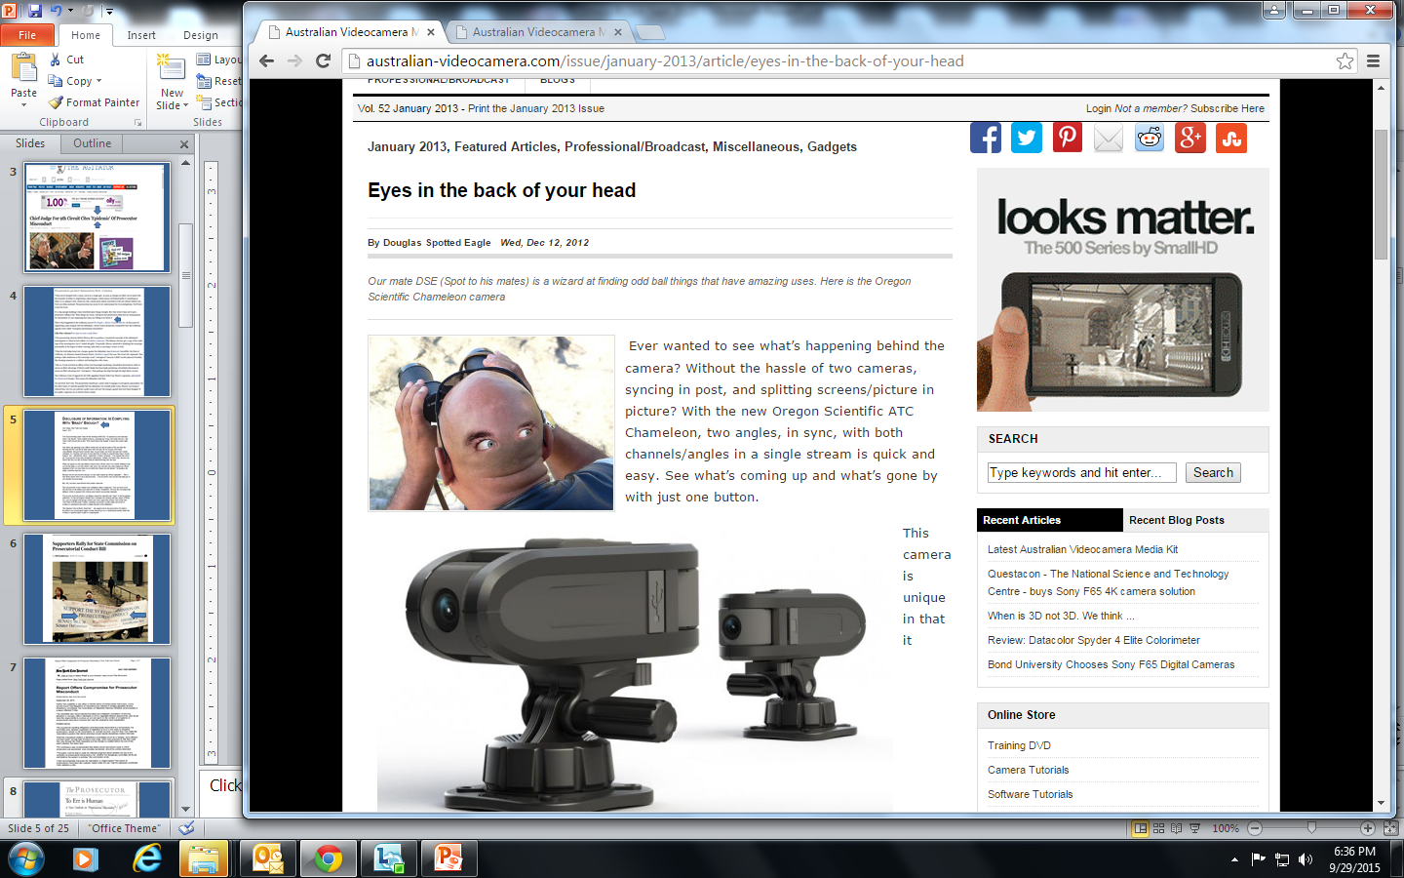
  Employ the “540 Look” when reviewing the evidence in your case folder
360 º
  + 90 º
  + 90 º
  540º

Slide 21
CASE REVIEW
QUESTIONS
(in your materials)

Slide 22
                Supervision

Slide 23
    Beware of the Gunslinger ADA
    Beware of the senior ADA who hasn’t come to grip with the fact that things are changing
    Beware of either the younger ADA, or the senior ADA, who resists change.
    Beware of the “unmotivated” ADA
Beware of the ADA who engages in “willful blindness” or “studied ignorance” when reviewing (or not reviewing) the evidence in his case

Slide 24
                Do the line prosecutors feel like they are working in a “gotcha” environment?
                Are subordinate ADAs encouraged to come to their supervisors with questions regarding ethical issues, even “dumb ones”?
                Do supervisors put a “puss” on when they are asked an ethical question at an “inconvenient time”?
                Do supervisors refrain from “huffing & puffing” when an ADA does come to them with an ethical problem?
                Is it the sense that ethics is only an issue of concern for the “front office”, or does it permeate the ethos of your office?
    Avoid creating “Win” / “Loss” environment

Slide 25
“It is not the strongest of the species that survives, nor the most intelligent that survives. It is the one that is the most adaptable to change.”
~ Charles Darwin ~

Slide 26
    Thank you for you attention

